Slide 1
FIN 740: Corporate Finance
Topic #1 – Capital Markets and Financial Management

Slide 2
This topic will cover three key questions…
What is the capital market?
What do financial managers do?
How is something’s value determined?

Slide 3
What is the capital market?
What is its purpose?
Who are the key players?

Slide 4
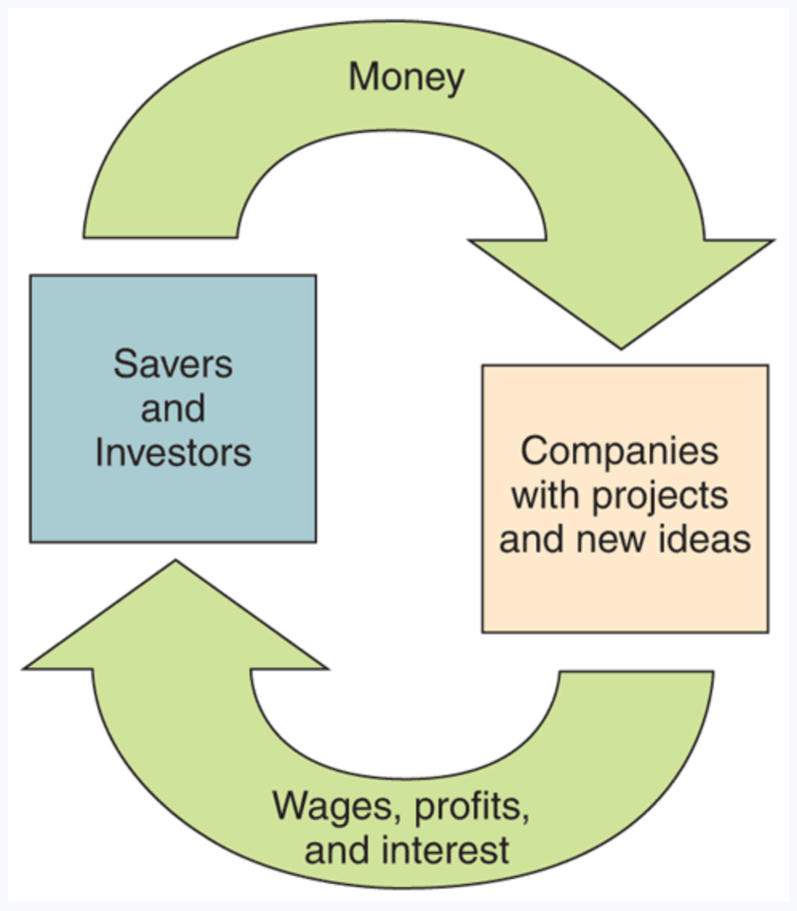
What is the capital market?
Capital market is where money from savers and investors is channeled to those seeking to raise cash
Leads to what book calls “the financial cycle”
Figure 1.5: Berk, Demarzo, and Harford, Fundamentals of Corporate Finance, 5th Edition

Slide 5
What institutions help channel money to firms?
Banks & credit unions
Insurance companies
Mutual funds
Pension funds
Hedge funds
Venture capital funds
Private equity funds
How do each of these work? I.e., who do they get money from, and how do they channel money to firms?

Slide 6
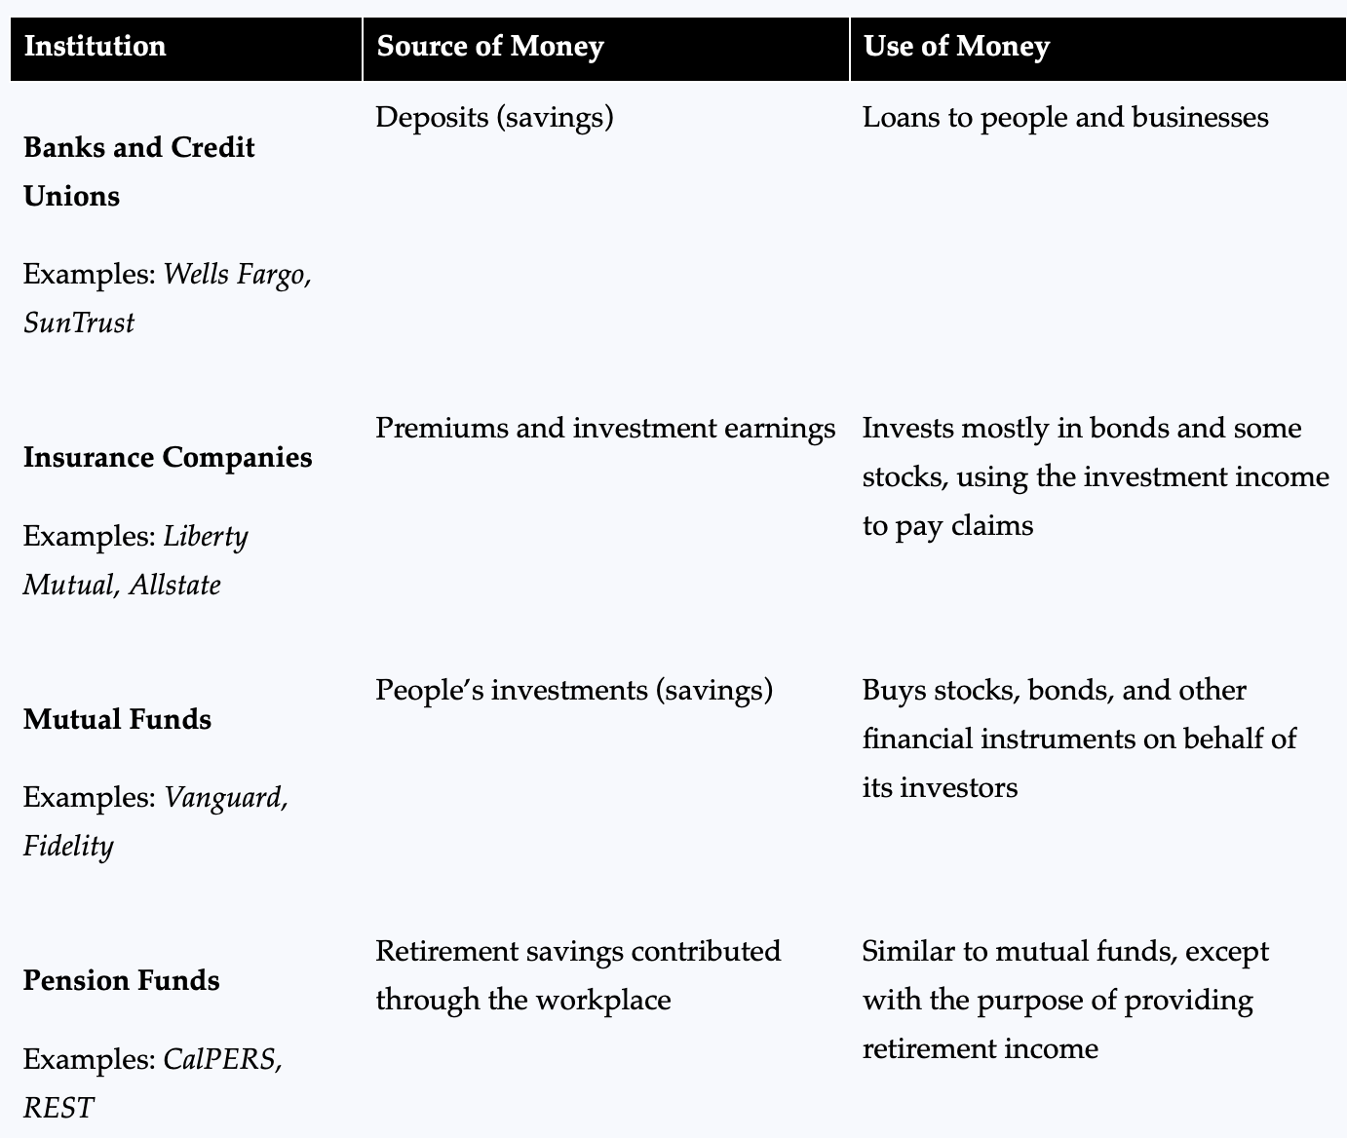
How do each of these work? I.e., who do they get money from, and how they channel money to firms?

Slide 7
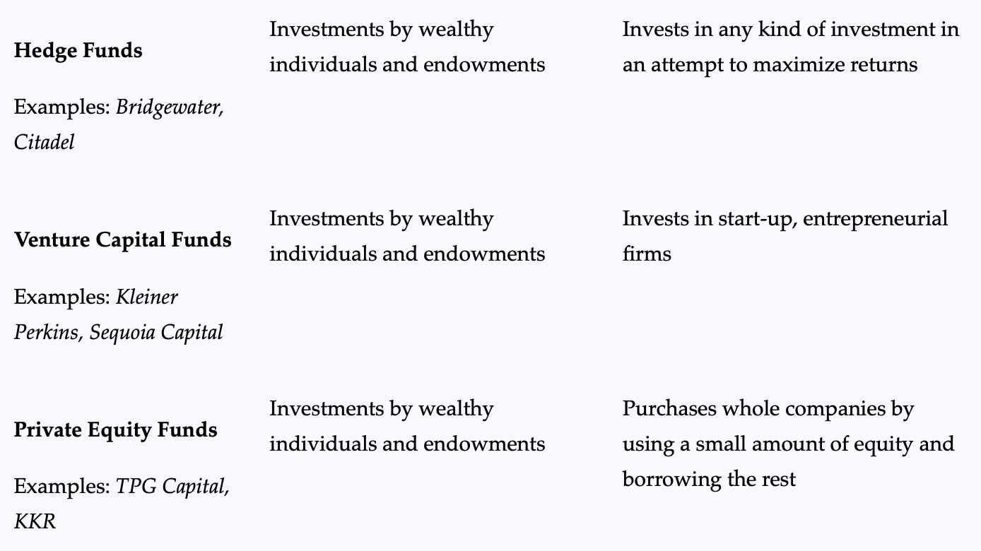
How do each of these work? I.e., who do they get money from, and how they channel money to firms?
Figure 1.6: Berk, Demarzo, and Harford, Fundamentals of Corporate Finance, 5th Edition

Slide 8
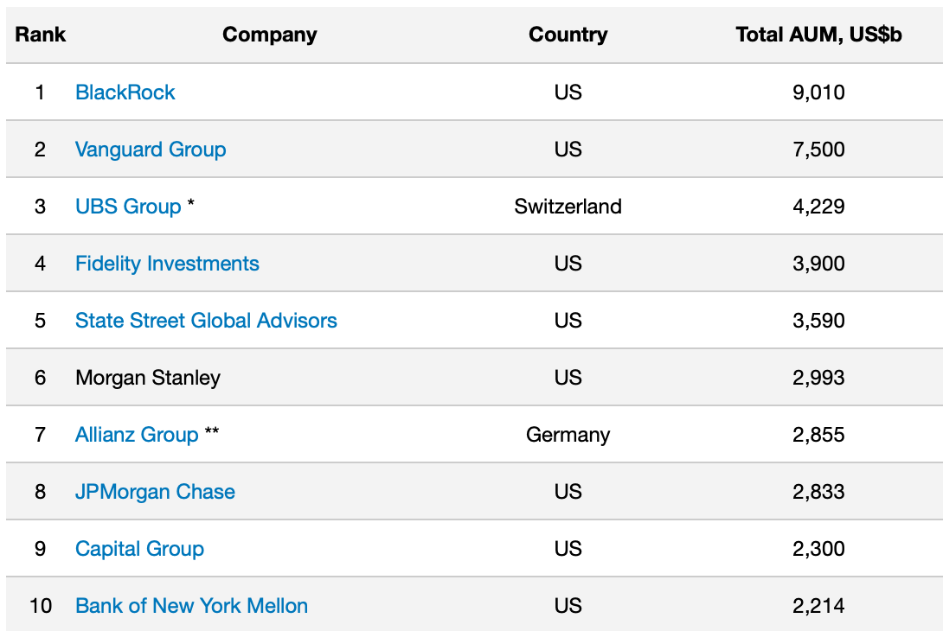
Some money managers are massive!
These are billions of US dollars!
What is different about #1, #2, and #5 money managers?
Global AUM as of March 31, 2021, as reported by www.advratings.com

Slide 9
The remaining piece…
So far, we have talked about the key players that help channel money to those seeking to raise cash…
But who are the buyers & suppliers of money, and what are their motives?

Slide 10
The buyers & suppliers of money
Buyers (i.e., those demanding money)
Companies (use to invest in projects)
Governments (use to provide services)
Individuals (use to purchase home, car, college, etc.)
Sellers (i.e., those supplying money)
Individuals (save for retirement, college, or other large purchases)

Slide 11
The price of using money
Price of using money = return demanded by the suppliers of money (i.e., investors & savers); i.e., it is the interest rate
If you borrow money for a car, the interest rate on the loan is the “price” charged by bank to convert your future loan payments into car now
And the interest rate you earn on your bank deposits is the “price” the bank pays to use your money (for things like making a car loan)
When we talk about firms, we call it their “cost of capital”
Intuitively, what factors will affect this (or any) price?

Slide 12
Determinants of interest rates
Interest rates (i.e., “price”) are determined by market forces based on the relative supply and demand of money
If supply increases (i.e., more people willing to lend money), “price” falls
If demand increases (i.e., more firms trying to borrow money), “price” rises
We will come back and talk in more detail in Topic #5 about what determines interest rates…

Slide 13
What do financial managers do?
I.e., what decisions do a company’s managers make?
How do these decisions interact with capital markets?
What is the goal of the financial manager?

Slide 14
Types of decisions made – Example #1
In December 2020, DoorDash did an initial public offering [i.e., it raised money by selling equity to institutions and retail investors for the first time]. Managers raised about $3.4 billion through the issuance, which is massive for a company valued at about $39 billion.
https://www.wsj.com/articles/doordash-poised-to-tap-torrid-ipo-market-11607442406

Slide 15
Types of decisions made – Example #2
In March 2021, Carvana decided to invest $500 million on 10 new inspection and reconditioning centers and hiring five thousand additional employees. As The Wall Street Journal reported, the company’s CFO, Mark Jenkins, felt consumer shifts to buying vehicles online would outlast pandemic.
Big decision for company with only 10,400 employees and $5.6 billion in revenues for 2020
https://www.wsj.com/articles/carvana-to-boost-capacity-betting-online-car-sales-are-here-to-stay-11616013522?mod=searchresults_pos15&page=1

Slide 16
Types of decisions made – Example #3
During the Covid-19 pandemic, many companies cancelled their dividends and began “hoarding record amounts of cash” according to The Wall Street Journal.
https://www.wsj.com/articles/companies-are-hoarding-record-cash-amid-delta-fears-11629106380?mod=searchresults_pos17&page=1

Slide 17
Financial management visually…
(1)
Cash raised from investors
Firm’s operations
(3a)
Financial markets
Cash reinvested
(2)
Cash flow from firm’s assets
Firm invests in assets
*
(3b)
Cash returned to investors
Government and other stakeholders
**

Slide 18
Three primary financial management decisions
How to raise capital? [“Capital structure” decision]
What mix of debt & equity?
What type of debt (e.g., loan vs. bonds)?
How to allocate capital? [“Capital budgeting” decision]
Should we launch a new product?
Should we acquire another company?
How to disperse net profits? [“Payout policy” decision]
Should we reinvest it in new projects?
Should we pay it out, and if so, how? [e.g., repurchase vs. dividend]

Slide 19
Examples – Apple Inc.
Here are some decisions Apple’s managers made:
Decided to expend substantial amounts to produce first iPhone in 2007
Decided to issue bonds for very first time in 2013
Ramped up dividends and share buybacks in 2013
What are these decisions each examples of?
https://www.wsj.com/articles/SB10001424127887324474004578442783946669310
https://www.wsj.com/articles/SB10001424127887323511804578298373069091776

Slide 20
What is the goal of the financial manager?
Choose one and choose wisely…
Avoid bankruptcy and survive
Maximize market share
Maximize wealth of the owners, the stockholders
Maximize managers’ own wealth
Maximize profits
Why not the other goals?

Slide 21
What happens if destroy shareholder value?
A vicious cycle ensues…
Value destruction
Lower financial returns and cash flows
Talented people leave
Less resources available to do value-enhancing projects; instead, focus on cutting costs & head count
More restricted access to capital

Slide 22
How do managers maximize shareholder value?
Choose investments that create most value
I.e., make good “capital budgeting” decisions
This will be a focus of the course
Choose financing to minimize cost of capital
I.e., make good “capital structure” decisions
This cost of capital is called “weighted average cost of capital” (WACC)

Slide 23
How is something’s value determined?
What is the value of a firm’s assets?
What is the value of a firm’s shares?

Slide 24
Value (from finance perspective)
A firm’s value is given by the present value of all the future cash flows the firm spins off, discounted at an appropriate, risk-adjusted cost of capital
Similar idea applies to a company’s stock; price equals present value of cash flows (i.e., dividends) from owning stock
Two key inputs
Cash flows created from invested capital
Discount rate (i.e., cost of capital)
Much of course will focus on teaching you how to find these two inputs!

Slide 25
Outline of this course
We will cover the tools managers use to make these decisions
Basic idea: managers must weigh the costs and benefits of each decision and compare them properly
These tools will also be useful in your own personal financial decisions! For example, they can help you answer questions like:
Is a particular stock a good investment?
How much should I save for retirement?

Slide 26
Warren Buffett case
In a few minutes, we’ll do a breakout session on the Warren Buffett case; let’s first setup the case & our goals

Slide 27
Case setting – August 25, 1995
Warren Buffett, CEO of Berkshire Hathaway (BRK), announced his firm would acquire remaining 49.6% of GEICO Corp.
Already owned 50.4%
Pre-announcement stock price of GEICO = $55.75
Announced purchase price = $70
This is a big deal…
Offering to buy remaining 33,673,229 shares @ $70/each
I.e., spending $2.35 billion!

Slide 28
About Berkshire Hathaway & market response
It is a holding company with large investments in many firms
E.g., owns newspaper, insurance, shoe, and candy companies
See Exhibits 1-3 of case
On announcement of the acquisitions, BRK’s shares increased 2.4% for a gain in market value of $718 million

Slide 29
About Warren Buffett
At time of case, estimated net worth of $7 billion
99% of this is from his 47.9% ownership stake in Berkshire Hathaway
Impressive investment track record: 28% annual growth in stock’s value from 1965 (when he bought BRK) to 1994
S&P 500 index averaged 14.3% annual return over the same period

Slide 30
Our purposes for doing this case
Establish basic, yet fundamental, finance themes
Economic reality vs. accounting numbers
Time value of money
Opportunity costs
Risk & return
Link valuation to investor behavior
An understanding of what stock prices reflect

Slide 31
Group assignment – Warren Buffett case
Take 60 minutes as group to answer questions on handout about Warren Buffett, the acquisition, and the market reaction
Upload answers as PDF, MS Word, or MS PowerPoint file to Canvas

Slide 32
Key points to remember
Capital market is where money from savers and investors is channeled to those seeking to raise cash
Managers interact with this market through the 3 key decisions:
How best to raise capital from the financial market?
How best to allocate capital that has been raised?
How best to disperse net profits to investors?
Managers’ goal when making these decisions is to maximize shareholder value (i.e., the return to investors)

Slide 33
Where we are going…
In next topic, we will discuss a key concept managers use to help them make decisions that maximize value, the “time value of money” mentioned in the Warren Buffett case
We will also discuss how to properly measure “value,” which will also be key to making these decisions
But first, any questions before we move on?

